Slide 1
Coursera Capstone Project
Corsera IBM Data Science
Mahya Bollers
March 13th,2019

Slide 2
Report content
Introduction
Problem to be resolved: Business problem
Data section :Data requirements and sources needed to solve the problem
The data acquired form Data.gov website and type of the file that choses is csv file because it is easier to manipulation and reading. Both files uploaded to my Github references. link to the files are:
https://catalog.data.gov/dataset/tourism-grants-17668
https://catalog.data.gov/dataset/times-square-entertainment-venues-c8ebb
Methodology section
Result section

Slide 3
Introduction
Manhattan has been described as the cultural, financial, media, and entertainment capital of the world, and the borough hosts the United Nations Headquarters
Tourism has a variety of economic impacts. Tourists contribute to sales, profits, jobs, tax revenues, and income in an area. The most direct effects occur within the primary tourism sectors -lodging, restaurants, transportation, amusements, and retail trade. Through secondary effects, tourism affects most sectors of the economy.
Times Square is a major commercial intersection, tourist destination, entertainment center and neighborhood in the Midtown Manhattan section of New York City. Times Square is sometimes referred to as "The Crossroads of the World. "The Center of the Universe, the heart of The Great White Way , and the "heart of the world”. One of the world's busiest pedestrian areas, it is also the hub of the Broadway Theater District and a major center of the world's entertainment industry

Slide 4
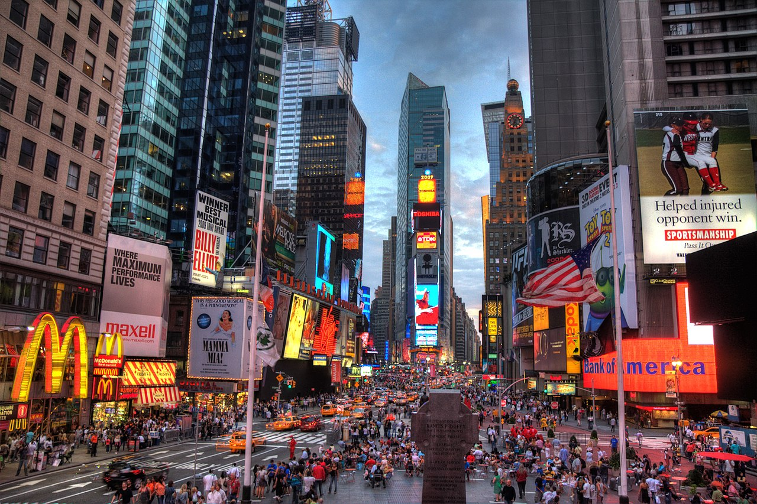
Manhattan Cultural Tourism Grant
Each year, New York City & Company Foundation funds and administers the Manhattan Cultural Tourism Grant – designed to support cultural-tourism marketing and audience-development initiatives that will expand awareness of the various neighborhoods throughout the borough of Manhattan.

Slide 5
1. Problem to be resolved:
The challenge to resolve is being able to find the location for opening a restaurant that acquirable to profit in Manhattan NYC . Therefore, in order to set a basic for comparison, I want to find a location unit subject to the following conditions:
Location close to Times square that has most visited tourist attractions.
Area that close to the recreational places that tourism grant facilities.

Slide 6
2 .How the data will be used to solve the problem.
The data will be used as follows:
Use Foursquare and geopy data to map top 10 venues for all Manhattan neighborhoods and clustered in groups (as per Course LAB) Use foursquare and geopy data to map the location of Times Square Entertainment Venues , separately and on top of the above clustered map in order to be able to identify the venues and amenities near each areas, with explore Using Foursquare. create a map that depicts the Tourism Grants organization near by Times square in Manhattan area . I will be able to quickly point to the popups to know the relative. Addresses and locations will be converted to geodata( lat, long) using Geopy-distance and Nominatim.

Slide 7
3. Data
The data acquired form Data.gov website and type of the file that choses is csv file because it is easier to manipulation and reading. Both files uploaded to my Github references. link to the files are:
https://catalog.data.gov/dataset/tourism-grants-17668
https://catalog.data.gov/dataset/times-square-entertainment-venues-c8ebb

Slide 8
3. Methodology section:
This section represents the main component of the report where the data is gathered, prepared for analysis. The tools described are used here and the Notebook cells indicates the execution of steps.
The analysis and the strategy:
The strategy is based on mapping the above described data in section 2.0, in order to facilitate the choice of at least two candidate places for opening the restaurant. The choice is made based on the demands imposed :location near a Times square, New York. This visual approach and maps with popups labels allow quick identification of location, feature to making the selection very easy.
The processing of these DATA and its mapping will allow to answer the key questions to make a decision:
What are the top 5 common venues in Manhattan?
How venues distribute among Manhattan neighborhoods and around Times square?
How much is the Amount Request for allocation of tourism facilities?
Where is the location of the organization?

Slide 9
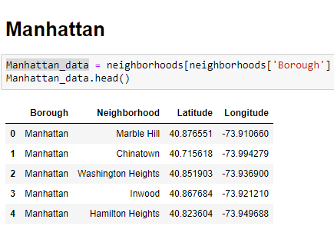
5. Executions and Results
STEP 1: choose to begin with Manhattan nighborhood .

Slide 10
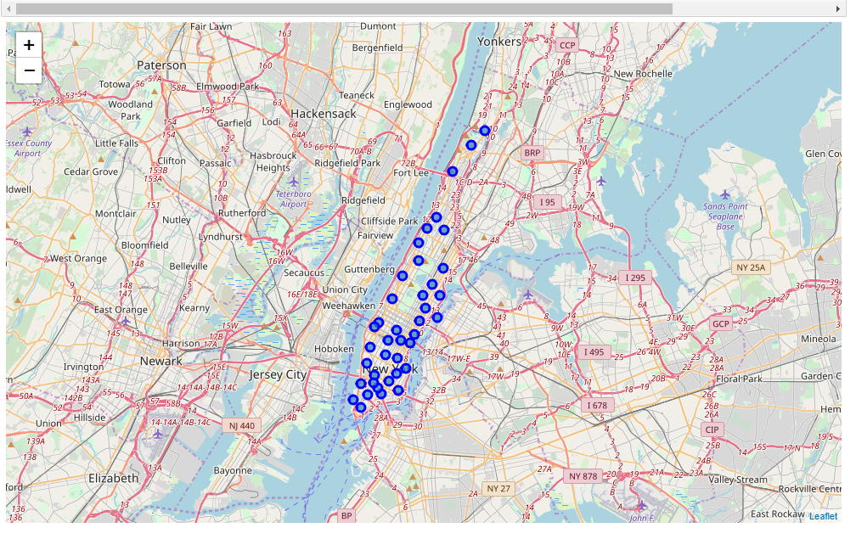
put the manhattan nighberhood on map:

Slide 11
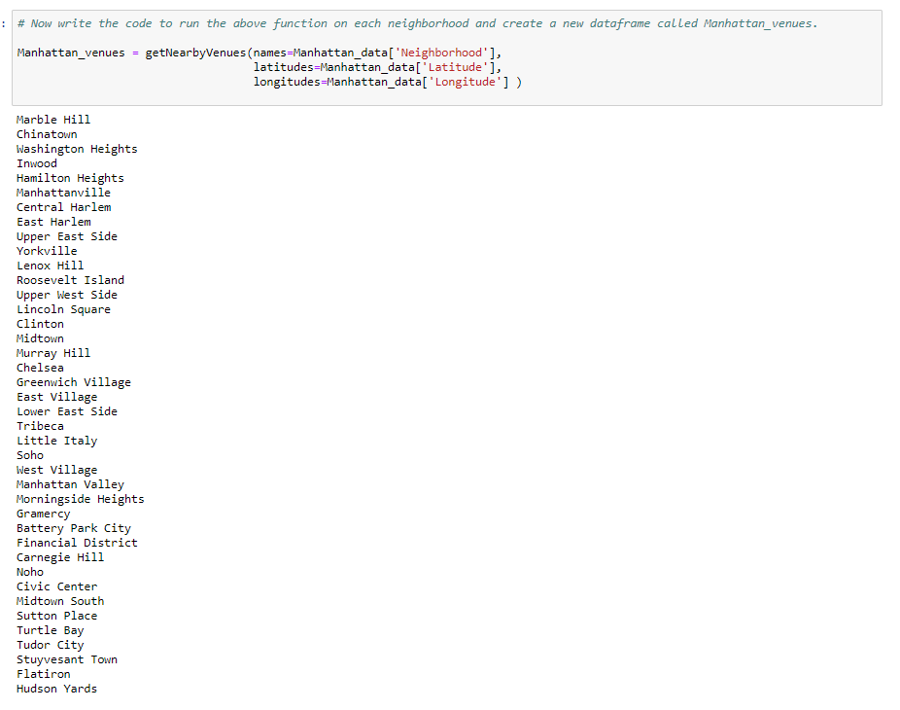
Explore Neighborhoods in Manhattan

Slide 12
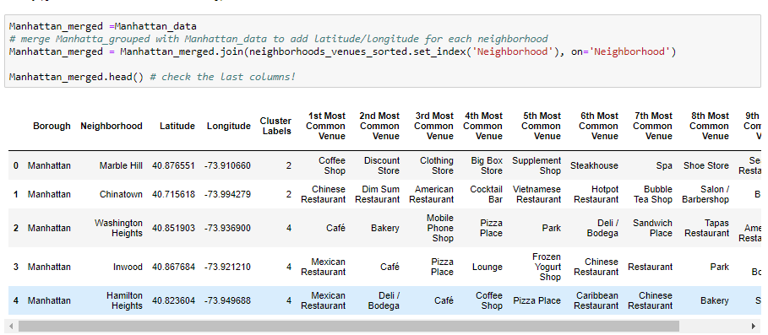
Analyze Each Neighborhood by the venues: The table analyzes the 5 top common venues in the Manhattan neighborhood and after that I put it in a new data frame so I can cluster the neighborhood and 10 must common venues

Slide 13
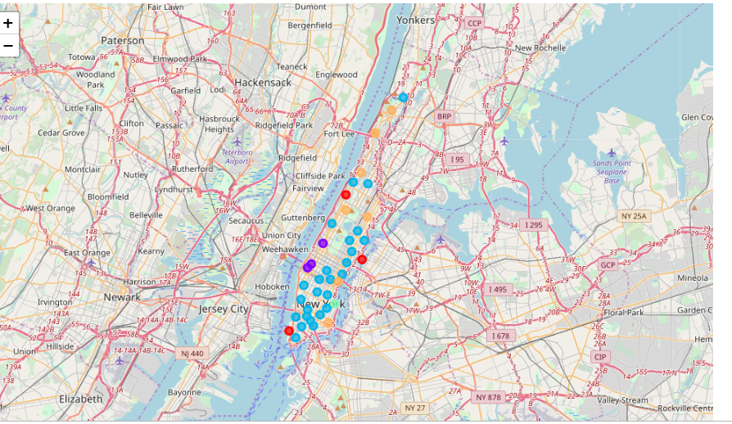
Performing Map of showing the cluster the neighborhood Visualize the most common venues in Manhattan neighborhood

Slide 14
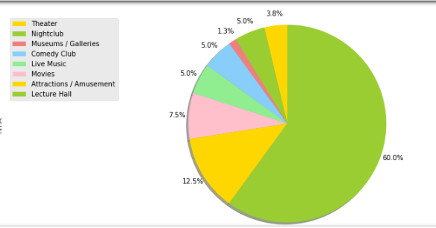
let's explore the most major commercial intersection in Manhattan area ,tourist destination in Manhattan: Times square Analyzing data to find out a subset of recreational places in time square that This list contains information on tourism grants After load the data now it’s time to see what is categories of subset of recreational places and performing them on a pie chart. As you can see that Lecture hall= 60% highest number of places in times square and Museums/Galleries=13% is the lowest number. And after that I using Folium map to show the locations of subindustry in times square.

Slide 15
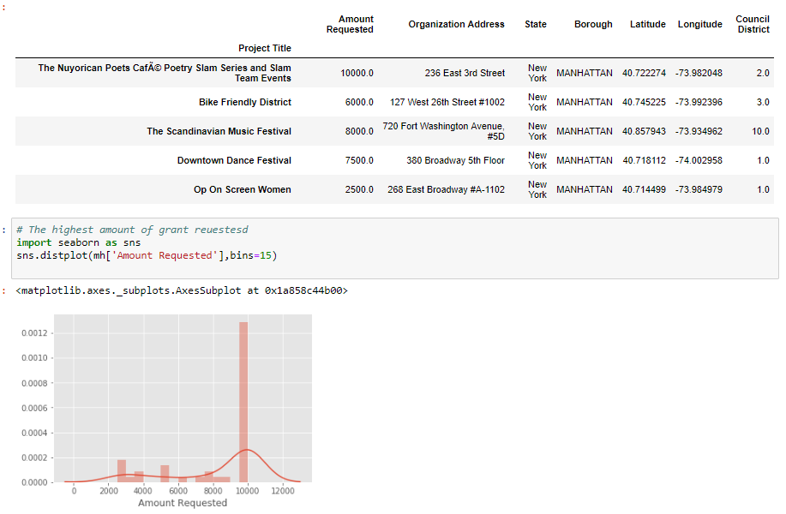
Let’s explore the Manhattan Cultural Tourism Grant After loading data and select the columns that I will need to analyze, and figure that out what is the most highest amount of Grants that dedicated to tourism project

Slide 16
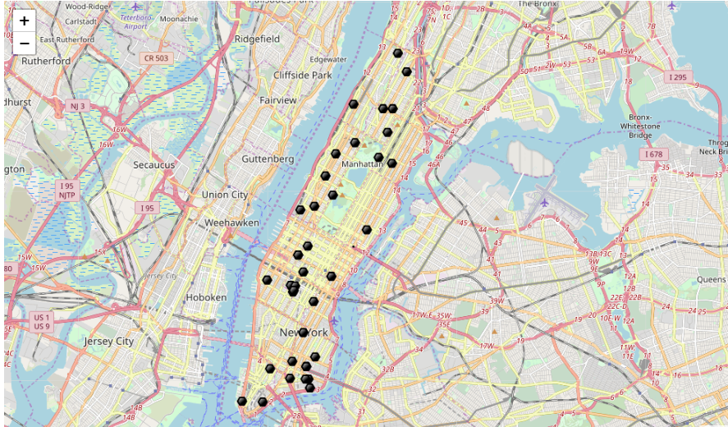
And using the folium map to find the locations in Manhattan area :

Slide 17
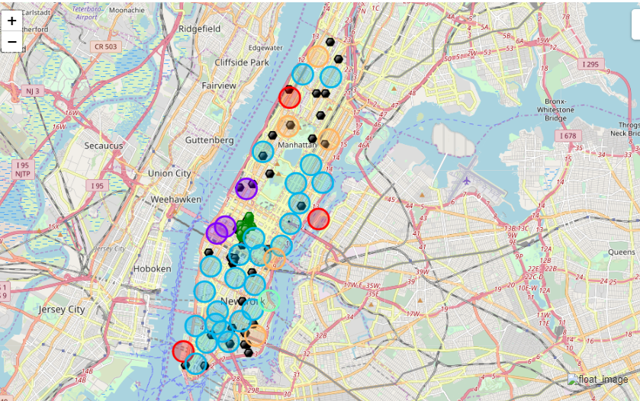
Result: Now it’s time to see with clustering the most common places in Manhattan and finding the most popular place in times square area that is most visited places for tourism . And also I collected the tourism attractions places that get more grant for growing so we can see where is the best place to open the restaurant.

Slide 18
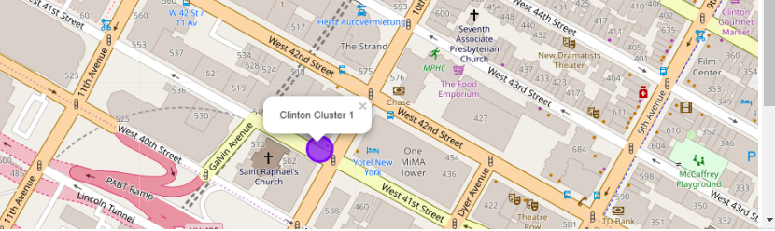
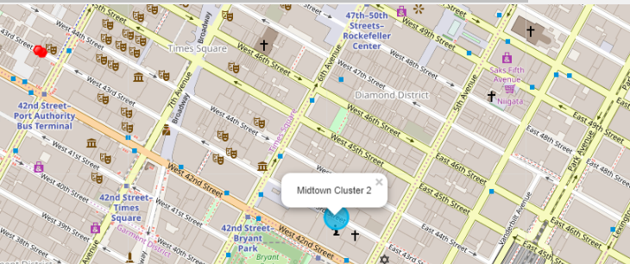
After examining, I have chosen two locations that meet the requirements which will assess to make a choice.

Slide 19
THANK YOU

